Slide 1
Employee Data Analysis using Excel
STUDENT NAME: B. Jancy rani
REGISTER NO: 312215011
DEPARTMENT: Commerce
COLLEGE: Soka ikeda college of arts and science for women

Slide 2
PROJECT TITLE
Employee Performance Analysis using Excel

Slide 3


AGENDA
Problem Statement
Project Overview
End Users
Our Solution and Proposition
Dataset Description
Modelling Approach
Results and Discussion
Conclusion
3/21/2024 Annual Review

Slide 4

PROBLEM STATEMENT

Slide 5

PROJECT OVERVIEW
Here’s a step by step guide on how to set up your excel spreadsheet to perform this analysis based on a project overview:
1.Data collection
• Employee information
•project details
•performance metrics
2.create the excel workbook
•Sheet 1: Employee data
•Sheet2: Project data
•Sheet 3: Performance Metrics
3. Data Analysis
•Calculate averages and total
•Create pivot tables
•Use conditional formatting
• performance rating calculation
4. Visualisation
• Create charts
•Dashboards

Slide 6

WHO ARE THE END USERS?
The end users of an employee performance analysis using typically include:
1.Managers/Supervisors
2. HR professionals
3.Employees
4. Executives
5.Performance review committee
6. Business analysts
Each group uses the analysis to fulfill their specific role in the organisation, leveraging the insights to drive better outcomes and improve over all company performance.

Slide 7
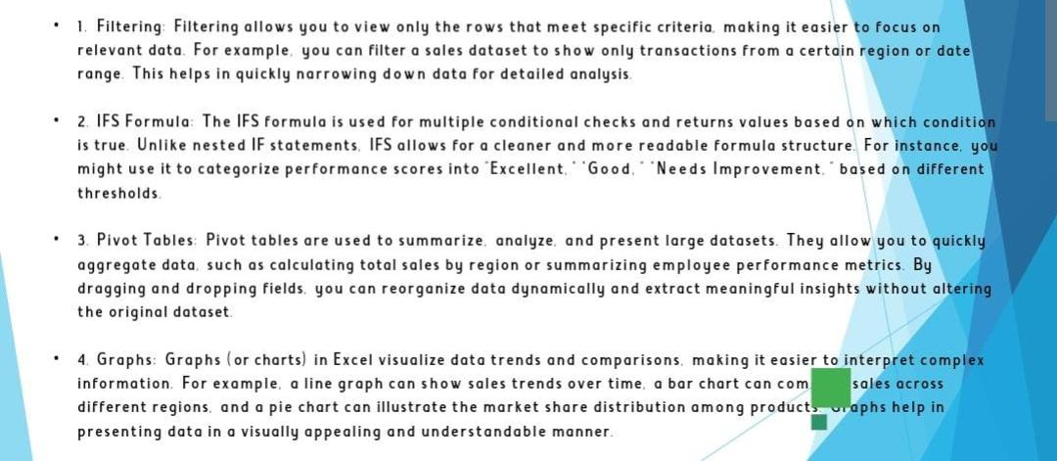

OUR SOLUTION AND ITS VALUE PROPOSITION

Slide 8
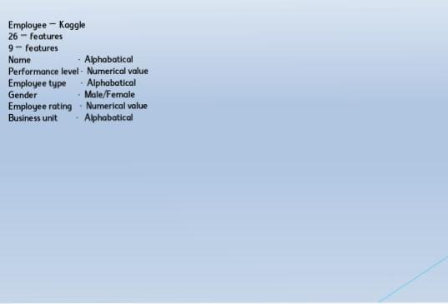
Dataset Description

Slide 9
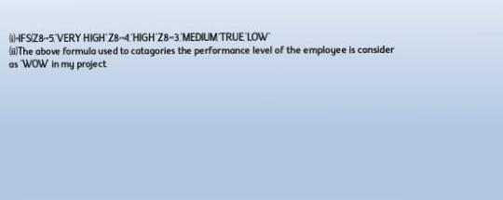

THE "WOW" IN OUR SOLUTION
3/21/2024 Annual Review
9

Slide 10
MODELLING
Analysis employee performance in excel involves gathering relevant data creating models and using various excel functions and tools to evaluate performance metrics. Here’s a basic guide on how to approach this
1.Gather data
•Collect employee data
• set KPIs
2. Data Organisations
•Create data table
• add a data column
3. Data analysis using excel function
• calculate performance matrix’s
• Weighted average
4. Using excel tools for analysis
•Pivot tables
• Conditional formatting
5. Employee performance model example
• rating model
• performance index
6. Forecasting and trend analysis
• Trendlines
• forecasting
10

Slide 11
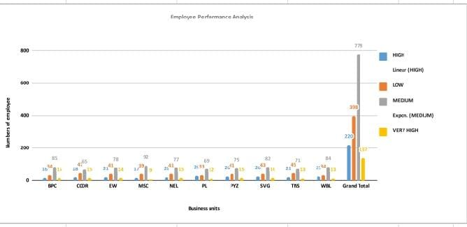
RESULTS
11

Slide 12
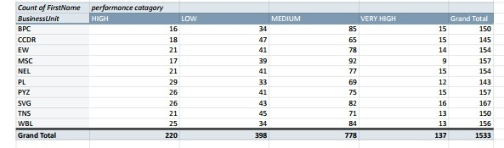

Slide 13
conclusion
Conclusion :
The analysis of employee performance reveals server key insights.firstly for insurance, employee in consistently perform above indicating. Conversely has shown areas needing improvement, particularly in specific metrics or behaviour.
Comparing performance against company bench marks , mention any significant deviation or alignments . For example specific observation which suggests that implication of the observation
Patterns observed include describe any relevant patterns. This correlation between and performance outcome highlights .
Based on these findings we recommend specific actions or program. Implementation recommended action could enhance aspect of performance while might address areas where performance lacking
Moving forward, it will be essential to suggest future actions such as continuous monitoring or revising performance metrics to ensure ongoing alignment with organisational goals.

